Slide 1


Team We_Ball
Business
STRATEGY
Domain 1: Enhancing Charity & Donations Through Fintech

Slide 2
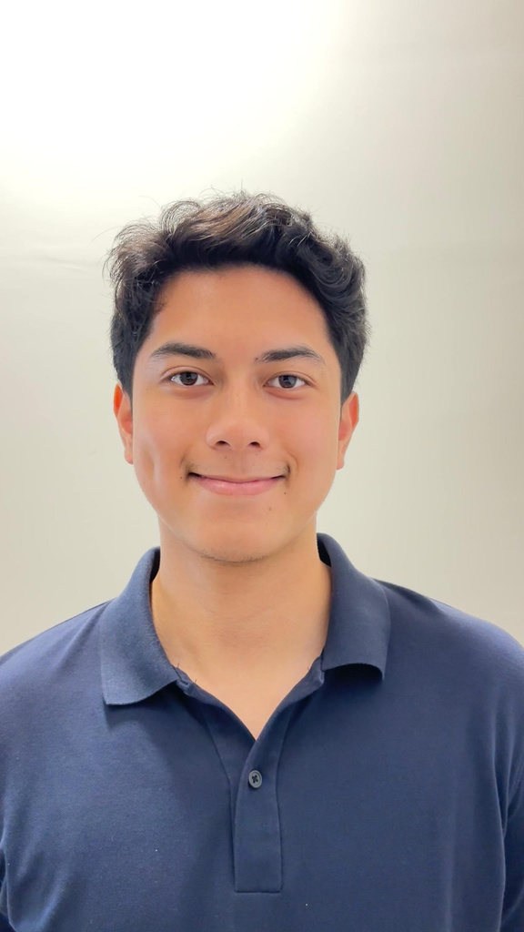
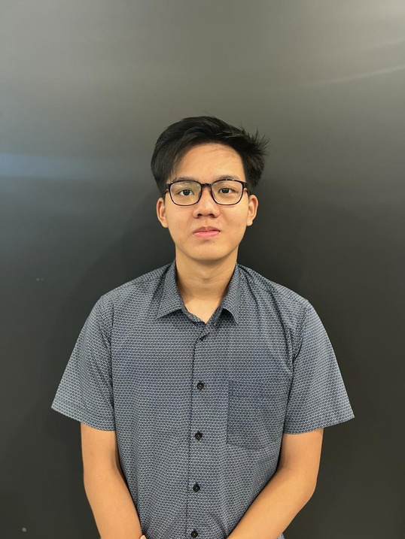
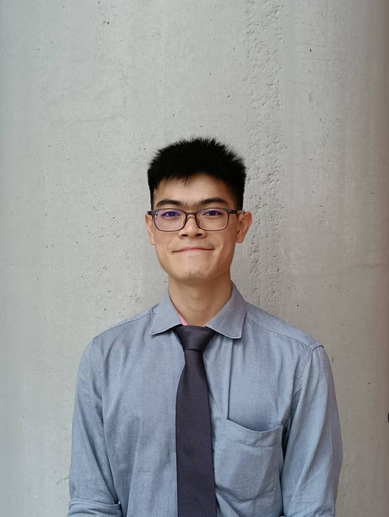
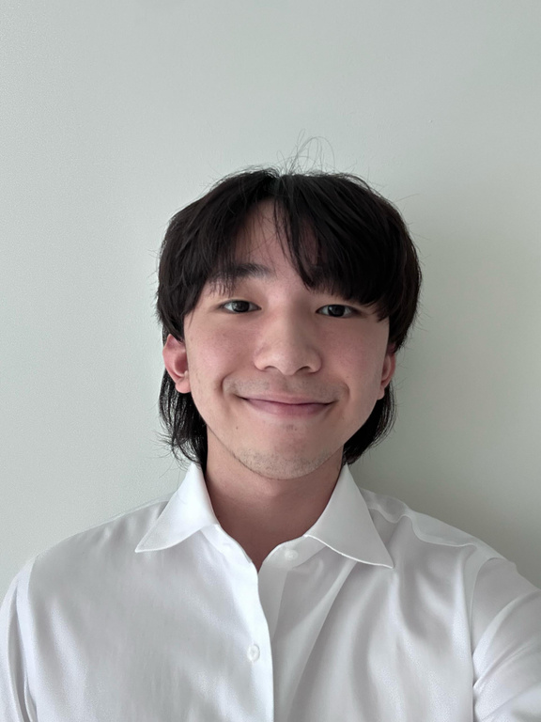
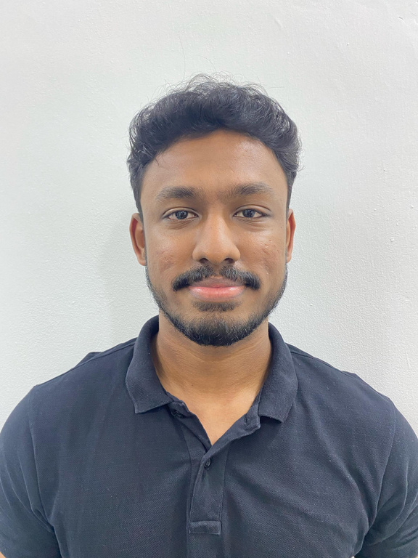

THE TEAM
Harris Muslisham
Cheah Thong Yau
Jonathan Yeo
Daren Tee
Haresh Thiyakarajan
Project manager
Analytics Specialist
Business manager
App Developer
App Developer

Slide 3




DO YOU FEEL...?
LACK OF TRANSPARENCY DONATING TO FUNDRAISERS?
NO DRIVE IN OFFERING A SMALL DONATION WITHOUT RETURNS?

Slide 4
EXISTING PLATFORMS
APP/PLATFORM | Strengths | Weaknesses
Etsy for Charity | Handmade Donations | Lacks Transaction Transparency
GoFundMe | High Donation Reach | Doesn’t Offer a Product in Return
Thrift for Good | Purpose-Driven Clothing | No Limited-Time Urgency

Slide 5





WHAT WE
•EXCLUSIVE, LIMITED-TIME MERCHANDISE TIED TO CHARITY CAUSES
•REAL-TIME TRANSPARENCY
OFFER
•LOYALTY REWARDS FOR CONSISTENT LOGINS
•GOVERNMENT-VISIBLE DONATIONS

Slide 6

Revenue
STREAMS
01
Purchases
02
Brand Sponsorships
Core product sales
Co-branded merchandise with NGO’s or creators
03
Loyalty Membership Program
Point system for extra benefits

Slide 7
BUSINESS ROADMAP
0-3 MONTHS
3 - 6 MONTHS
6 - 9 MONTHS
9 - 12 MONTHS
12 ++ MONTHS
Prototype
The main functions are made with considerations of future addition to the app.
MVP
The app is in the least functioning state where basic and main functions work and is has backend working.
Alpha Stage
Seeking out enterprisers to sponsors and help soft launch
Beta Stage
Implement and taking scalability to consideration
Launch Stage
Nationwide

Slide 8
Proposed
SOLUTION
Let’s look at the overview of our app!

Slide 9

Why companies will sponsor?
Revenue
Publicize themselves for a good cause
Gain more positive attention
Win-win situation
70% - Raise for charity
30% - Keep the company running

Slide 10
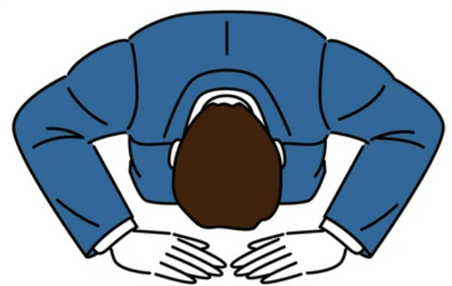
THANK YOU
For Listening

Slide 11

Question
&
ANSWER

Slide 12




We_Ball
CONTACT US FOR FINALS?!
jonajk111@gmail.com
+60 13-849 7429
Asia Pacific University

